Slide 1
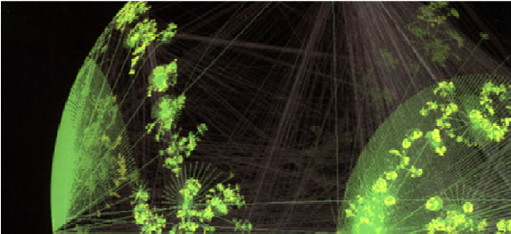

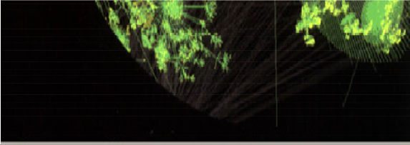
Chapter 2
Panvar
A Single Segment Network
– DDaattaa Link Layer
TCP/IP Essentials A Lab-Based Approach

Slide 2
Data Link Layer
Main tasks of the data link layer:
TCP/IP Suite
–Transfer network layer data from one machine to another machine via “a data link”.
Application Layer
–Convert the data between raw bit stream of the physical layer and groups of bits → bytes
→ frames.
Transport Layer
Network Layer
Data Link Layer
–Perform flow control between sender and receiver
Error Detection and Correction
Sliding Window Protocols
Physical Layer

Slide 3
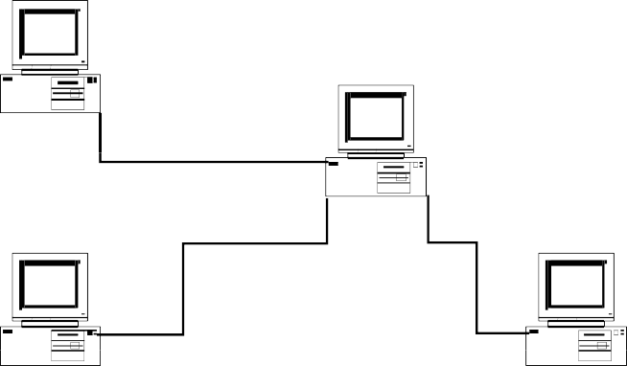
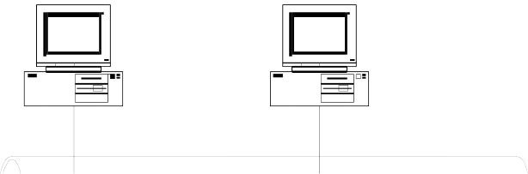
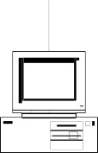
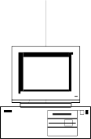
Types of Networks
Point-to-point network
Each link connects two end points: hosts or any network devices
Usually for long distance connections
Examples: DSL, POS (Packet over SONET/SDH), GbE (Gigabit Ethernet)
Point-to-Point Network
Broadcast network
A number of stations share a common transmission medium
Usually for local networks
Examples: CSMA/CD Ethernet, WLAN (Wireless Local Area Network), a.k.a. Wi-Fi
Broadcast Network

Slide 4
Possible Services
Unacknowledged connectionless service
Frame is sent with no connection / error recovery
Ethernet is example
Acknowledged connectionless service
Frame is sent with retransmissions if needed
Example is 802.11
Acknowledged connection-oriented service
Connection is set up; rare

Slide 5
Multiple Access
•Network topology
–Point-to-point → N(N-1)/2 links to connect N nodes
–Broadcast → the shared medium forms a single domain
•Medium access control (MAC) protocols
–Rules to share a medium
–Carrier Sense Multiple Access/Collision Detection (CSMA/CD)
– Carrier Sense Multiple Access/Collision Avoidance (CSMA/CA)

Slide 6




Point-to-Point Protocol
– point-to-point network example
The Point-to-Point Protocol (PPP) is a data link protocol
The main purpose of PPP is encapsulation and transmission of IP datagrams, or other network layer protocol data, over a serial link.
Currently, PPP is used by most dial-up Internet access, Digital Subscriber Loop (DSL), and cable broadband services.
DSL example
central office
telephone network
DSL
splitter
DSLAM
modem
ISP
voice, data transmitted at different frequencies over dedicated line to central office
DSL access multiplexer

Slide 7
PPP Encapsulation
PPP frame format
• Flag: mark the beginning and ending of a frame
•Protocol: used to multiplex different protocol data
•No addressing, only two end hosts.
Flag
Addr.
Ctrl.
Protocol
Data
CRC
Flag
7E | FF | 03 |  |  |  | 7E
1 byte | 1 byte | 1 byte | 2 bytes | ≤ 1500 bytes | 2 bytes | 1 byte
 |  |  | 0021 | IP Datagram
 |  |  | C021 | Link Control Data
 |  |  | 8021 | Network Control Data

Slide 8
Point-to-Point Protocol (RFC 1661)
PPP consists of two types of control protocols:
Link Control Protocol (LCP)
Responsible for agreeing on PPP encapsulation options, packet size limits, and detecting common mis-configuration errors over the data link
Optional features to provide peer authentication, detect link status
Network Control Protocol (NCP)
PPP supports a family of NCPs and treat each network protocol like an interface
IP Control Protocol (IPCP, RFC 1332), used for configure the link to transmit IP datagrams

Slide 9
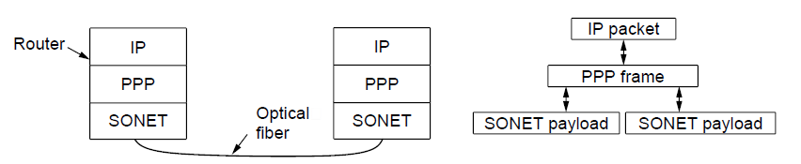
Packet over SONET
Packet over SONET is the method used to carry IP packets over SONET optical fiber links
Uses PPP (Point-to-Point Protocol) for framing
Protocol stacks
PPP frames may be split over SONET payloads

Slide 10
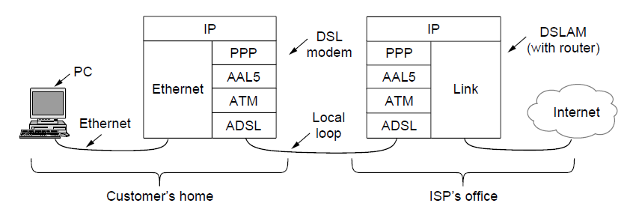
ADSL (1)
Widely used for broadband Internet over local loops
ADSL runs from modem (customer) to DSLAM (ISP)
IP packets are sent over PPP and AAL5/ATM (over)

Slide 11
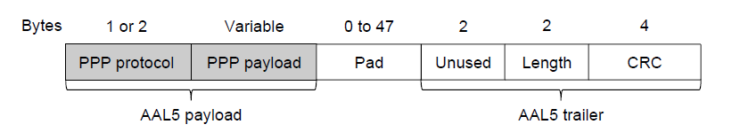
ADSL (2)
PPP data is sent in AAL5 frames over ATM cells:
ATM is a link layer that uses short, fixed-size cells (53 bytes); each cell has a virtual circuit identifier
AAL5 is a format to send packets over ATM
PPP frame is converted to a AAL5 frame (PPPoA)
AAL5 frame is divided into 48 byte pieces, each of which goes into one ATM cell with 5 header bytes
Notes:
Re ATM: ATM was a major technology in the 1990s that was hyped to win in the convergence of the Internet and telecommunications, but IP won instead. The short, fixed-size cells give flexibility (can mix voice and data without having the voice wait for a whole data packet). ATM is now used in niches such as ADSL and WAN links.

Slide 12
Why did Ethernet Win?
There are LOTS of LAN protocols
Price
Performance
Availability
Ease of use
Scalability
AT the time an Ethernet card costs $40, AN ATM card cost $1000

Slide 13
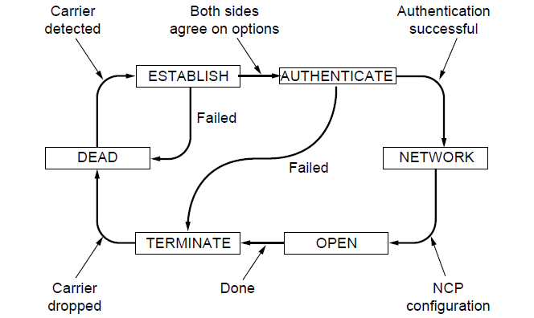
PPP (2)
A link control protocol brings the PPP link up/down
State machine for link control

Slide 14
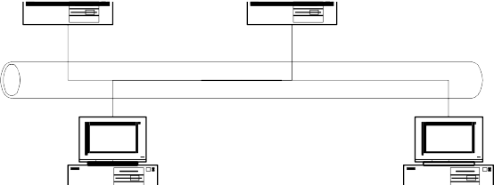
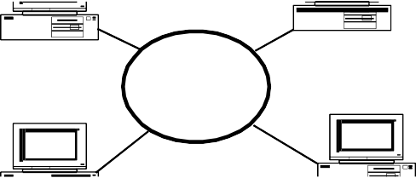
Local Area Networks
Local Area Networks (LANs) typically connect computers within a building or a campus.
Many LANs are broadcast networks.
Bus and Ring are two typical LAN topologies used in early days
The protocol that determines who can transmit on a broadcast channel is called Medium Access Control (MAC) protocol.
Bus LAN
Ring LAN

Slide 15
MAC and LLC
In any broadcast network, the stations must ensure that only one station transmits at a time on the shared communication channel.
The protocol that determines who can transmit on a broadcast channel is called Medium Access Control (MAC) protocol.
The MAC protocol is implemented in the
to Network Layer
MAC sublayer which is the lower sublayer
Data Link Layer
Logical Link Control
of the data link layer.
The higher portion of the data link layer
Medium Access
Control
is often called Logical Link Control (LLC).
to Physical Layer

Slide 16
Logical Link Control
LLC can provide different services to the network layer:
unacknowledged connectionless service
acknowledged connectionless service
connection-oriented service
Framing
Error control
Addressing

Slide 17
Media Access Control
MAC algorithms are used to resolve collisions and share the medium in a broadcast network.
Examples of MAC:
ALOHA
Carrier Sense Multiple Access/Collision Detection (CSMA/CD)
Carrier Sense Multiple Access/Collision Avoidance (CSMA/CA)
Ethernet
Originally developed at Xerox PARC at 2.94 Mbps data rate over coaxial cable based on CSMA/CD, 1972 – 1977
An industry standard since 1982 (DIX Ethernet), or
Based on CSMA/CD adopted by IEEE 802 committee in 1985
Interoperates with 802.2 (LLC) as higher layer
Uses different encapsulation header to carry data payload

Slide 18
Collisions in Ethernet
The collision resolution process of Ethernet requires that a collision is detected while a station is still transmitting.
Assume the maximum propagation delay on the bus is a.
Restrictions: Each frame should be at least twice as long as the time to detect a collision (2a).
t₀
A Begins Transmission
A
B
t₀+a- 
B Begins Transmission
A
B
t₀+a
B Detects Collision
A
B
t₀ +2a
A detects collision just before end of transmission
A
B

Slide 19
CSMA/CD Flow Diagram
1.Each station listens before it transmits.
Station has data to send
2.If the channel is busy, it waits until the
channel goes idle, and then it transmits.
New Attempt
Wait according to the backoff algorithm (5)
3.If the channel is idle it transmits
immediately and continue sensing for
2a seconds.
Sense Channel (1)
Channel Busy (2)
4.If collision is detected, transmit a brief jamming signal then cease transmission.
Channel Free (2)
Transmit data and sense channel (3)
Collision Detected
Transmit jam signal (4)
No Collision
5. Wait for a random time, and retransmit. The random time is determined by
Complete
Transmission
exponential backoff algorithm.

Slide 20

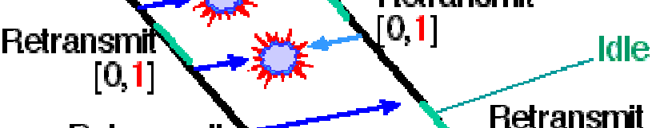
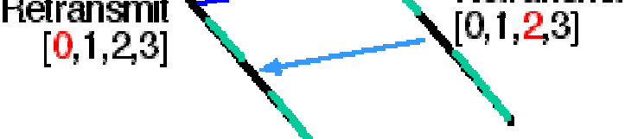
Exponential Backoff Algorithm
•If a station is involved in a collision, it waits a random amount of time before attempting a retransmission.
•The random time is determined by the following algorithm:
–Set “slot time” to 2a.
–After first collision wait 0
or 1 time unit.
–After the i^{th} collision, wait a random number between 0 and 2^{i}-1 time slots.
– Do not increase random number range if i>9.
– Give up after 16
collisions.
[G. Fairhurst]

Slide 21


Ethernet Switches
In an Ethernet LAN, hosts can be
Attached to a common cable, or
Connected by Ethernet switches.
A
B
C
Ethernet switches are MAC layer devices that switch frames between ports connected to different LAN segments.
Offer guaranteed bandwidth for segments.
Separate a LAN into collision domains.

Slide 22
Ethernet Encapsulation (RFC 894)
Dest. Addr | Src. Addr. | Type | Data | CRC
.
6
6
2
46-1500
4
Type 0800
IP
datagram
2
46-1500
Type 0806 | ARP req./reply | PAD
2
28
18
- Dest. Addr., Src. Addr.:
MAC addresses are 48 bit
Type 8035 | RARP req./reply | PAD
2
28
18
- Type:
Identifies the content of the data field (must ≥ Ox0600)
cyclic redundancy check
- CRC:

Slide 23
IEEE 802.2/802.3 Encapsulation
802.3 MAC
802.2 LLC
802.2 SNAP
Destination address
Source address
Length
DSAP SSAP cntl Org code AA AA 03 0
type
Data
CRC
6 6 2 1 1 1
- Destination address, Source address:
MAC addresses are 48 bit (displayed
3
2
38-1492
4
0800
IP datagram
as 12 hexadecimal characters)
frame length in number of bytes (<Ox0600, 1,500 bytes → Ox05dc)
- Length:
2
38-1492
0806
ARP request/reply
PAD
DSAP, SSAP:
Ctrl:
Org code:
Type field:
always set to set t o 3
set to 0
identifies the content of the
0xaa
2
28
10
8035
RARP request/reply PAD
2
28
10
data field
cyclic redundancy check
- CRC:
Total frame size: 64 bytes to 1518 bytes
Overhead: 38 bytes including 12 bytes Inter Frame Gap (IFG)

Slide 24
The Address Resolution Protocol
IP addresses are not recognizable in the interface layer where physical addresses (or MAC addresses) are used.
Different kinds of physical networks use different addressing schemes.
Address Resolution Protocol (ARP): maps an IP address to a MAC address per RFC 826.
Reverse Address Resolution Protocol (RARP): maps a MAC address to an IP address per RFC 903.

Slide 25
ARP Process
•When a source host wants to send an IP packet to a
destination, it first broadcasts an ARP request asking for the MAC address corresponding to a ttaarrggeett IIPP aaddddrreessss.
•A ttaarr ggeett ddeevviiccee will return an ARP reply with its MAC address.

Slide 26
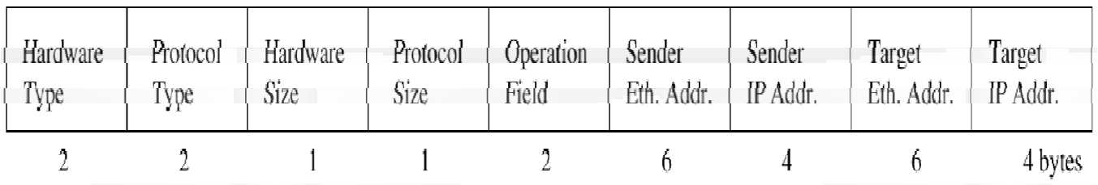
ARP Packet Format
28 bytes long.
An ARP request or ARP reply is encapsulated in an Ethernet frame.
– The protocol type in Ethernet frame is set to 0x0806 for ARP messages.
Hardware Type - Specifies a hardware interface type for which the sender requires a response, i.e. Ethernet (1) in our case
Protocol type - Specifies the type of high-level protocol address the sender has supplied, ie. IP (Ox0800) in our case
Hlen - Hardware address length.
Plen - Protocol address length.
Operation field specifies ARP request (1), ARP reply (2), RARP request (3), or RARP reply (4).

Slide 27
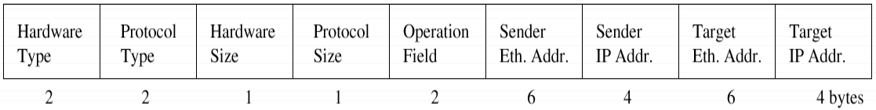
ARP Request
Ethernet destination: ff:ff:ff:ff:ff:ff (broadcast address)
Target Ethernet Address: not set.

Slide 28
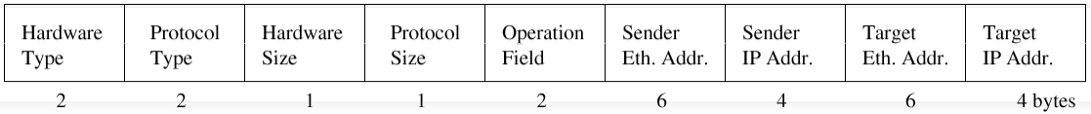
ARP Reply
The ARP reply is sent by the node whose IP address matches the target IP address in the ARP request.
It fills its MAC address into the target Ethernet address field of the ARP request.
It then swaps the two sender addresses (Ethernet and IP addresses) with the two target addresses, sets the op field to 2.
The ARP reply is sent back to the source host only.
All other nodes receiving the broadcast ARP Request record the MAC and IP of the Sender

Slide 29
ARP Cache
•Sending an ARP request/reply for each IP datagram is inefficient.
•Each host maintains an ARP cache containing the recent resolved IP addresses.
•A source host first checks its ARP cache for the destination MAC address,
If an entry is found, sends out the IP packet within an Ethernet frame.
Otherwise, sends out an ARP request.

Slide 30
Manipulating the ARP Table
•Elements of an entry in the ARP table:
An IP address
A MAC address
Flags
•A normal entry expires after 20 minutes after it is created or the last time it is referred.
•Manipulate ARP table by the arp command:
arp –a: Displays all entries in the ARP table.
arp –d: Deletes an entry in the ARP table.
arp –s: Inserts an entry into the ARP table.

Slide 31
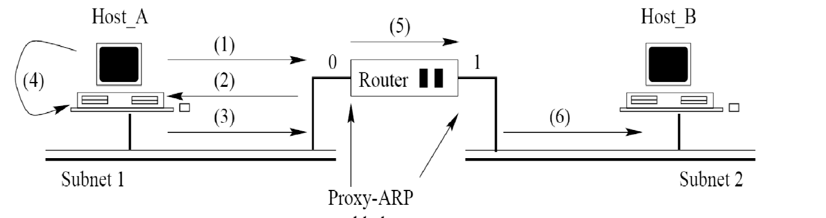
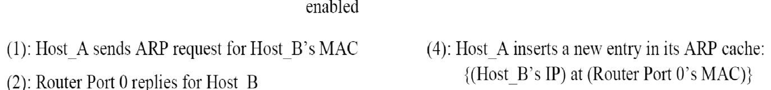
Proxy ARP (RFC 1027)
Hide the two physical networks from each other.
A router answers ARP requests targeted for a host.
Physical Network 1
Physical Network 2
Note
Two networks are logically in the same subnet (at least from Host As point of view …)
Often used by a router connecting to a host with a serial link, ex. PPP to Host B
’

Slide 32
Gratuitous ARP
Occurs when a host sends an ARP request resolving its own IP
address.
Usually happens when the interface is configured at bootstrap time.
The interface uses gratuitous ARP to determine if there are other hosts using the same IP address.
The sender’s IP and MAC address are broadcast, and other hosts will insert this mapping into their ARP tables.

Slide 33
DHCP Function: High Level
DHCP Server
Client
Send My Configuration Information
IP Address: 10.10.10.101 Subnet Mask: 255.255.255.0 Default Routers: 10.10.10.1 DNS Servers: 192.168.10.4, 192.168.10.5 Lease Time: 10 days
Here Is Your Configuration
Server dynamically assigns IP address on demand
Administrator creates pools of addresses available for assignment
Address is assigned with lease time
DHCP delivers other configuration information in options

Slide 34
DHCP Function: Lower Level
DHCP Server
Client
DHCP Discover (Broadcast)
DHCP Offer (Unicast|Broadcast)
DHCP Request (Broadcast)
DHCP Ack (Unicast|Broadcast)
See: DHCP defined by RFC 2131

Slide 35
Loopback Interface
Most IP stack implementations have a loopback interface with IP address
127.0.0.1 and named as localhost.
The localhost behaves as a separate data link interface.
A packet that is sent to the loopback interface moves down the protocol stack and is returned back by the driver software for the localhost “device”.
Used for debugging.
Packets sent to loopback interface will not appear on network.

Slide 36
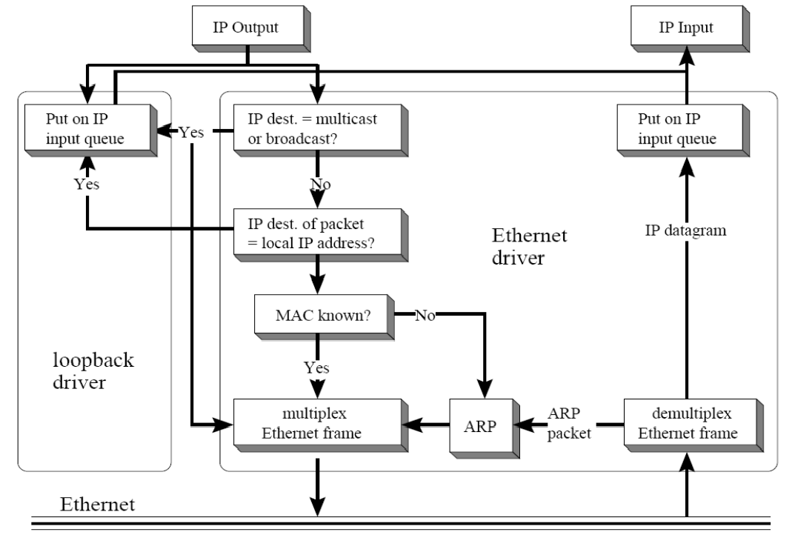
Network Interface Operations
Functional Diagram of an Ethernet Interface Card

Slide 37
Maximum Transmission Unit
There is a limit on the data packet size of each data link layer protocol.
This limit is called Maximum Transmission Unit (MTU).
MTUs for various data link layers:
Ethernet, PPP: 1500 bytes
FDDI: 4352 bytes
PPP (low delay): 296 bytes
MTU does not count its own header and trailer bytes of the data link protocol. e.g. Ethernet’s MTU is 1500 bytes.
Dest. Addr | Src. Addr. | Type | Data | CRC
.
6
6
2
46-1500
4

Slide 38
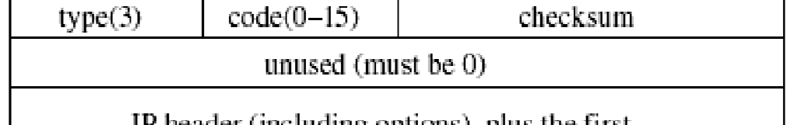
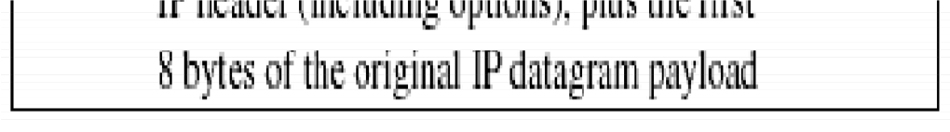
Internet Control Message Protocol
The Internet Control Message Protocol (ICMP) is the protocol used for error and control messages in Internet.
ICMP provides an error reporting mechanism of routers to the sources.
All ICMP packets are encapsulated as IP datagrams (IP protocol type 1)
The packet format is simple.
Example below shows destination unreachable error message below:

Slide 39
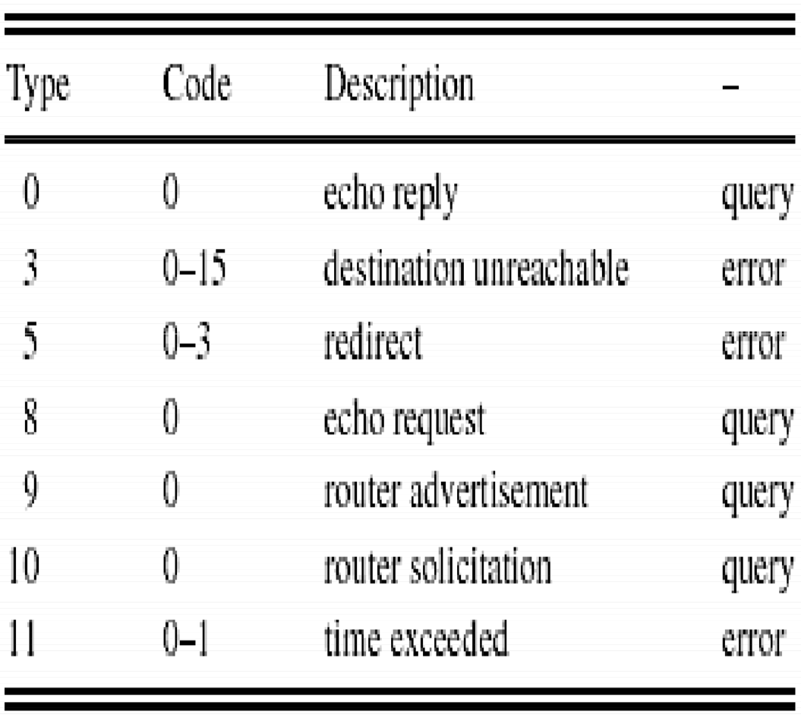
Types of ICMP Packets
Many ICMP packet types exist, each with its own format.

Slide 40
ICMP Message Types
ICMP messages are either query messages or error messages.
ICMP query messages:
Echo request / Echo reply
Router advertisement / Router solicitation
Timestamp request / Timestamp reply
Address mask request / Address mask reply
ICMP error messages:
Host unreachable
Source quench
Time exceeded
Parameter problem

Slide 41
ICMP Error Messages
Each ICMP error message contains the header and at least the first 8 bytes of the IP datagram payload that triggered the error message.
To prevent that too many ICMP messages, ICMP error messages are NOT sent
for multiple fragments of the same IP datagrams
in response to an error message
in response to a broadcast packet

Slide 42
ICMP Type 3 Error Message Code
There are 16 different ICMP error messages (‘codes’) of type “Destination Unreachable” (Type = 3)
Code Message Type
0 Network unreachable
Host unreachable
Protocol unreachable
Port unreachable
Fragmentation needed but bit not set Source route failed
Code Message Type
Source host isolated
Destination network administratively prohibited Destination host administratively prohibited Network unreachable for TOS Host unreachable for TOS
10
1
12
5
6
Destination network unknown
Destination node unknown
13
Communication administra- tively prohibited by filtering Host precedence violation
7
14
15
Precedence cutoff in effect

Slide 43


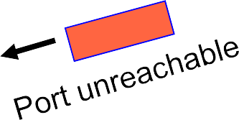
ICMP Port Unreachable
If, in the destination host, the IP module cannot deliver the datagram because the indicated protocol module or process port is not active, the destination host may send a port unreachable message to the source host.
No process is waiting at Port 1234
Client
Server

Slide 44
ICMP Port Unreachable
Format of the Port Unreachable Message
ICMP Message
Ethernet Header
IP Header
ICMP
Header
IP header of datagram from client
at least 8 bytes from IP payload of client
8 bytes
Type (= 3)
Code (= 3)
Checksum
Note: both UDP and TCP store the
Unused (Set to 00...0)
Port Number in the first 8 bytes!

Slide 45
Packet InterNet Gopher (PING)
PING is a program that utilizes the ICMP echo request and echo reply messages.
PING is used to verify if a certain host is up and running. It is used extensively for fault isolation in IP networks.
PING can be used with a wide variety of options, e.g.
-R (Record route): includes the RECORD_ROUTE option in the ECHO_REQUEST packet and displays the route buffer on returned packets.
-s packetsize: specifies the number of data bytes to be sent (default is 56) (in newer implementations, -s is used to continuously generate queries)

Slide 46

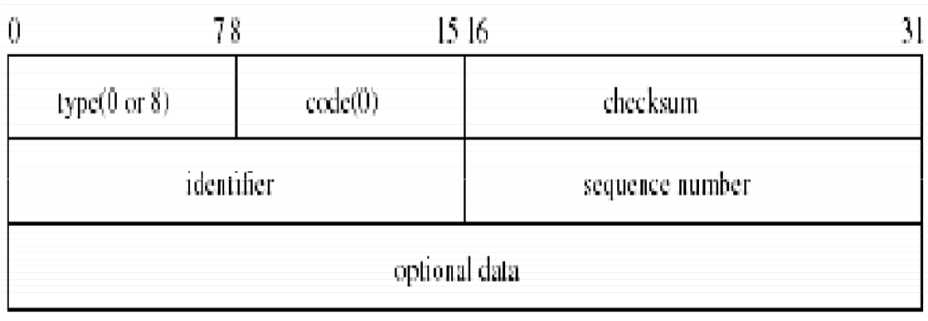
Echo Request and Reply
Ping’s are handled directly by the kernel.
Each Ping is translated into an ICMP Echo Request.
The Ping’ed host responds with an ICMP Echo Reply.
Host 1
Host 2
Message format
Identifier is set to process ID of querying process.
Sequence number is incremented for each new echo request.

Slide 47
Sock Traffic Generator
Sock is a test program.
Can be run as a client or as a server
Use UDP or TCP.
stdin
TCP Connection
Sock
Server
stdout
Sock operates in one of the following four modes:
Interactive client
> Copy data from stdin, send to server, receive data back from server, copy on screen (stdout)
Interactive server
> Wait for a request from client
Source client
> Send packets to a specific server
Sink server
> Receive packets from a client and discard the data

